Slide 1
BASIC LOGIC GATES

Slide 2
Logic gates are an important concept if you are studying electronics. These are important digital devices that are mainly based on the Boolean function. Logic gates are used to carry out logical operations on single or multiple binary inputs and give one binary output. In simple terms, logic gates are the electronic circuits in a digital system.

Slide 3
Types of Basic Logic Gates
There are several basic logic gates used in performing operations in digital systems. The common ones are
OR Gate
AND Gate
NOT Gate
XOR Gate
Additionally, these gates can also be found in a combination of one or two. Therefore, we get other gates, such as NAND Gate, NOR Gate, EXOR Gate and EXNOR Gate.

Slide 4
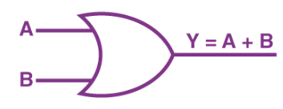
OR Gate
In an OR gate, the output of an OR gate attains state 1 if one or more inputs attain state 1.
The Boolean expression of the OR gate is Y = A + B, read as Y equals A ‘OR’ B.

Slide 5
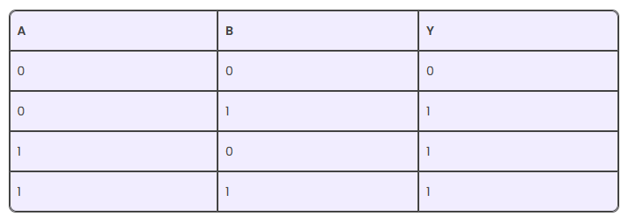
The truth table of a two-input OR basic gate is given as

Slide 6
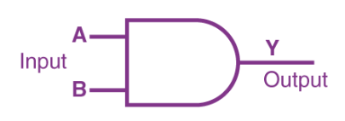
AND Gate
In the AND gate, the output of an AND gate attains state 1 if and only if all the inputs are in state 1.
The Boolean expression of AND gate is Y = A.B

Slide 7
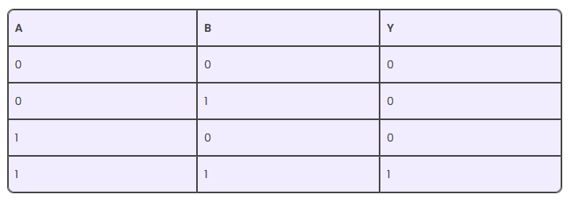
The truth table of a two-input AND basic gate is given as

Slide 8

NOT Gate
In a NOT gate, the output of a NOT gate attains state 1 if and only if the input does not attain state 1
The Boolean expression is read as Y equals NOT A.

Slide 9

The truth table of NOT gate is as follows

Slide 10
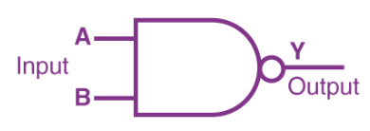
NAND Gate
This basic logic gate is the combination of AND and NOT gates.
The Boolean expression of the NAND gate is

Slide 11
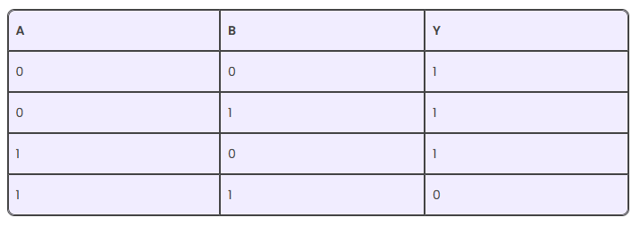
The truth table of a NAND gate is given as

Slide 12
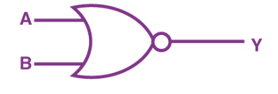
NOR Gate
This gate is the combination of OR and NOT gates.
The Boolean expression of the NOR gate is

Slide 13
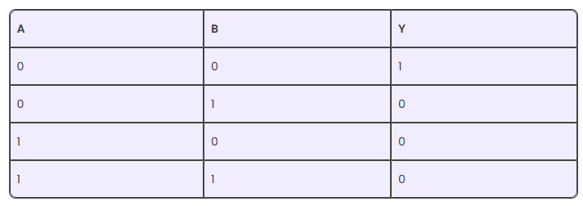
The truth table of a NOR gate is as follows

Slide 14

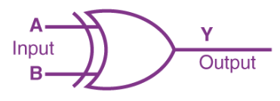
Exclusive-OR gate (XOR Gate)
The Boolean expression of the XOR gate is

Slide 15
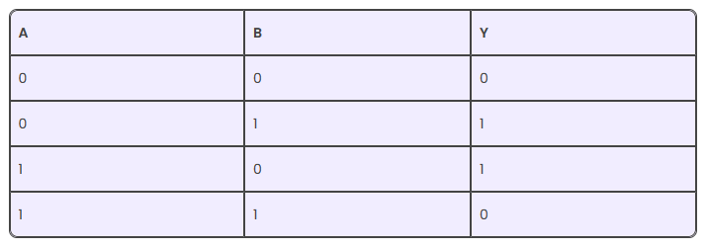
The truth table of an XOR gate is

Slide 16


Exclusive-NOR Gate (XNOR Gate)
In the XNOR gate, the output is in state 1 when both inputs are the same, that is, both 0 or both 1.
The Boolean expression of the XNOR gate

Slide 17
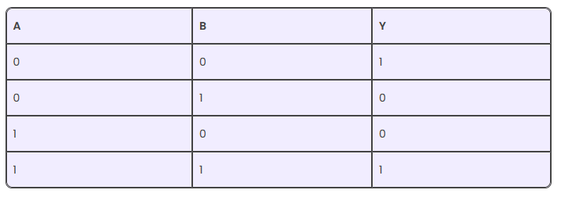
The truth table of an XNOR gate is given below

Slide 18
Application of Logic Gates
Logic gates have a lot of applications, but they are mainly based on their mode of operations or their truth table.
Basic logic gates are often found in circuits such as safety thermostats, push-button locks, automatic watering systems, light-activated burglar alarms and many other electronic devices.

Slide 19


De Morgan’s Theorem
The first theorem – It states that the NAND gate is equivalent to a bubbled OR gate.
The second theorem – It states that the NOR gate is equivalent to a bubbled AND gate.

Slide 20
Important Conversions
(1) The ‘NAND’ gate: From ‘AND’ and ‘NOT’ gates.
(2) The ‘NOR’ gate: From ‘OR’ and ‘NOT’ gates.
(3) The ‘XOR’ gate: From ‘NOT’, ‘AND’ and ‘OR’ gates.
(4) The Exclusive-nor (XNOR) gate XOR + NOT

